Slide 1
LEARNING OBJECTIVES
CODING 101: HTML + CSS
Gain an overview of HTML/CSS within the web development landscape.
Describe the basic components of HTML, CSS, and Javascript.
Understand the difference between front/back-end coding
Use HTML and CSS to mark up a basic webpage.
Describe roles/jobs that benefit from an understanding of HTML/CSS.
Describe the various opportunities to continue learning web-development.
Notes:
Get 6 volunteers to read out loud, the objectives.
Today, students will:
Get a bit of a feel for the "web"
Learn the basics of HTML and CSS
Build a very basic website

Slide 2
WWW
HOW DOES THE WORLD WIDE WEB WORK?

Slide 3
WWW
CLIENT
(Browser)
SERVER
REQUEST
RESPONSE
Notes:
CLIENT is typically your browser in this context
Clients make ‘requests’
Servers send ‘responses’ - which are a bunch of files/resources….

Slide 4
Notes:
Essentially all a web page really is is a collection of files. Every blog post, every tweet on Twitter, every hilarious cat photo, every Amazon product page. They're just files stored on special computers that you're accessing through a network.
The special computers that store all these internet files are called “servers” or “hosts.” Personal computers like the one you’re using right now are called “clients.”

Slide 5
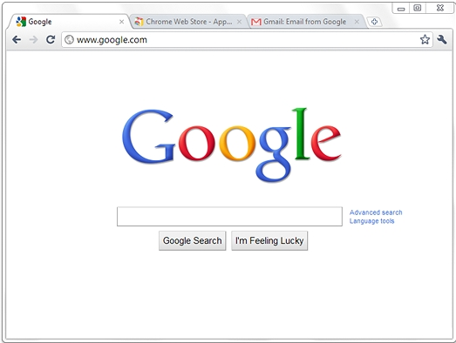

www.nexgencodecamp.com.au
DNS (Domain Name Server)
Notes:
Let’s look at a single interaction ie. what happens when we attempt to fetch a webpage
Browser > Issue Request > DNS resolution

Slide 6
www.nexgencodecamp.com.au
200.100.10.1
DNS (Domain Name Server)
Notes:
DNS search can be complex but it is simplified here
DNS sends back an IP address

Slide 7

www.nexgencodecamp.com.au
200.100.10.1
DNS (Domain Name Server)
Fetch 200.100.10.1 from Web Server
Notes:
The IP address sent back is unique on the internet
Our browser can now use it to go (effectively) directly to the computer that holds our website

Slide 8
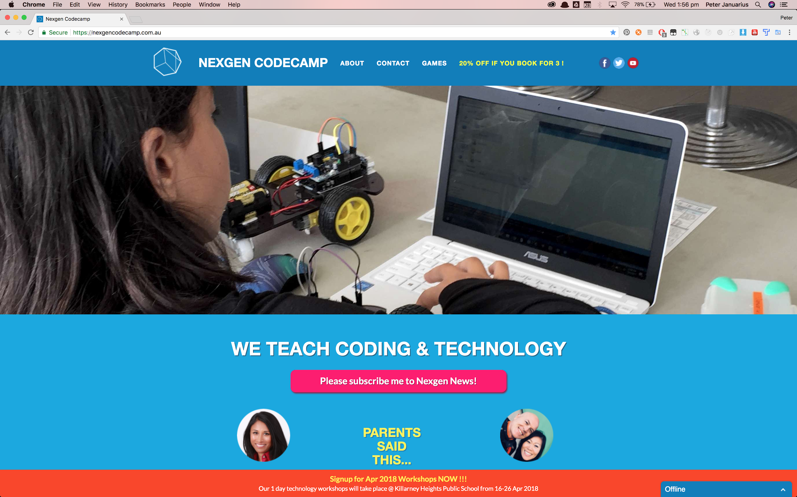
www.nexgencodecamp.com.au
200.100.10.1
DNS (Domain Name Server)
Send back page/files
Fetch 200.100.10.1 from Web Server
Notes:
The web server sends back the files to our computer
They are rendered on the browser
Could talk about Internet history at this point
1969 - Arpanet, 1972 - Email, 1977 - Queen sends an email

Slide 9

SO, WHAT’S WEB DEVELOPMENT?

Slide 10
WHAT’S WEB DEVELOPMENT?
The creation and maintenance of websites and/or web-apps
Consists of Front End and Back End
“A creative (usually) team based process that involves great attention to detail, design, lots of iteration, problem solving and solution building”
Notes:
‘Iteration’ points to the fact that there may be a workflow!

Slide 11
WHERE DOES FRONT END WEB DEVELOPMENT FIT IN?
WEB PRODUCTION WORKFLOW

Slide 12
WEB PRODUCTION WORKFLOW
Information Architecture
Design
FE Development
BE Development
User Experience (UX)
Notes:
Development is iterative
IA is first - structure and content
Design makes information palatable and desirable
UX runs through the entirety and has even wider implications
FE & BE run in parallel

Slide 13
WHAT DOES FRONT END EVEN MEAN?
“A mix of HTML (structure/content), CSS (style/layout) & Javascript (interaction & heavy lifting) that results in a visual web application/website.”
Notes:
These days a commercial FEDev needs to be expert in a whole string of skills
The above are the tip of the iceberg

Slide 14
“The answer is simple: front end development, like any specialized trade or spectator sport, is a lot harder than it looks. It isn’t until you’ve dipped your toes in it that you realize just how turbulent the waters are.”
— Ilias Ismanalijev, Why is it so hard to find a good front end developer?
Notes:
Ilias Ismanalijev is a Co-Founder and FED
He is probably getting at the array of choices and the speed of change

Slide 15


Slide 16
CODING QUOTES

Slide 17
"Debugging is twice as hard as writing the code in the first place. Therefore, if you write the code as cleverly as possible, you are, by definition, not smart enough to debug it."
- Brian W. Kernighan.

Slide 18
"People think that computer science is the art of geniuses but the actual reality is the opposite, just many people doing things that build on each other, like a wall of mini stones."
- Donald Knuth.

Slide 19
“Always code as if the guy who ends up maintaining your code will be a violent psychopath who knows where you live.”
— Martin Golding
Notes:
Attributed to Google Groups comment in 1994

Slide 20
THE BACK END

Slide 21
WHAT IS THE BACK END?
WEB DEVELOPMENT
Database code
Calculation engines
Web services and APIs
Many languages to choose from:
Ruby (Ruby on Rails), Node.js, PHP, Python, C++ etc.

Slide 22
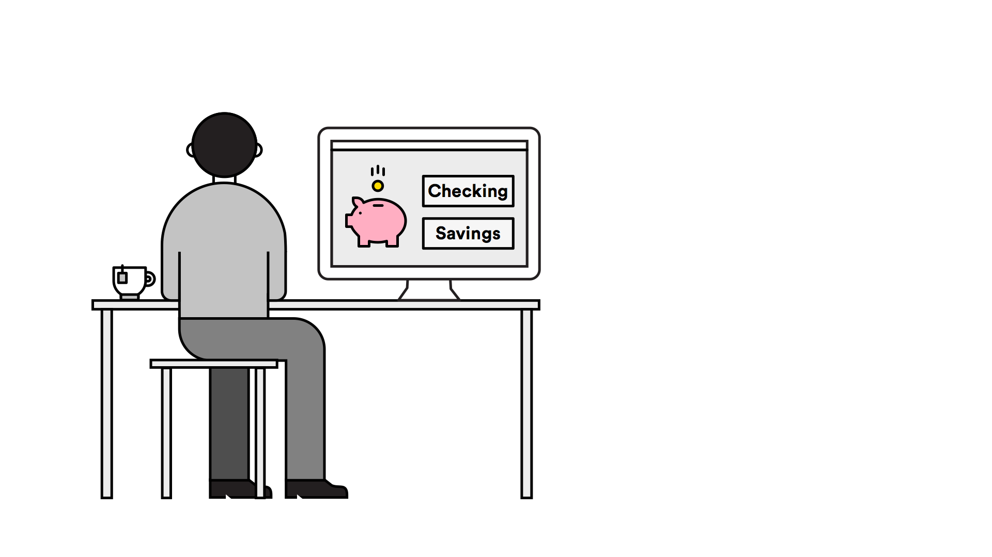
Notes:
Let’s walk through how the Front End and the Back End are functioning in an example user interaction.

Slide 23
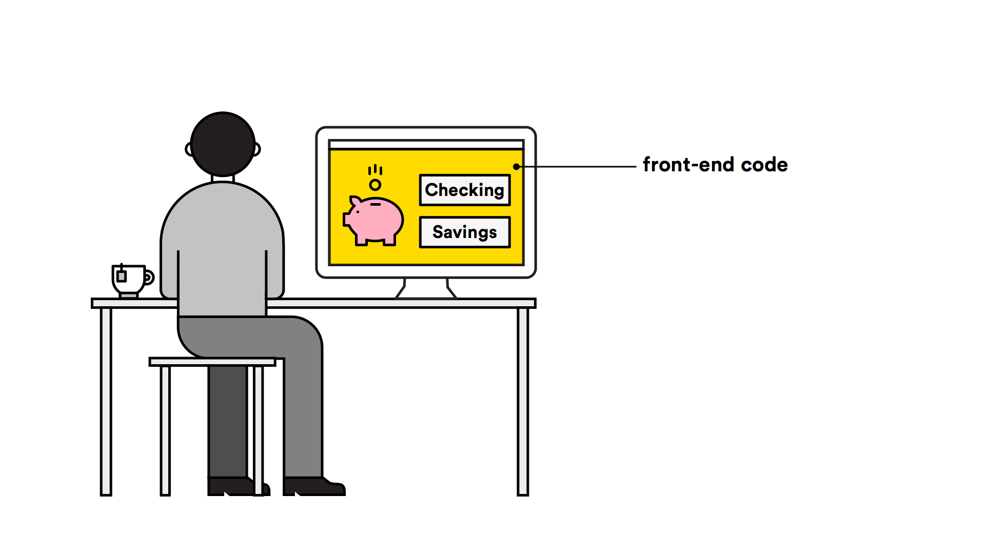
Notes:
The front end is everything the user sees
AND a lot of stuff the user doesn’t

Slide 24

Notes:
Now, the user clicks into his checking account. This is when the back end kicks in, because the website needs to find his information, which has been stored in a database.

Slide 25
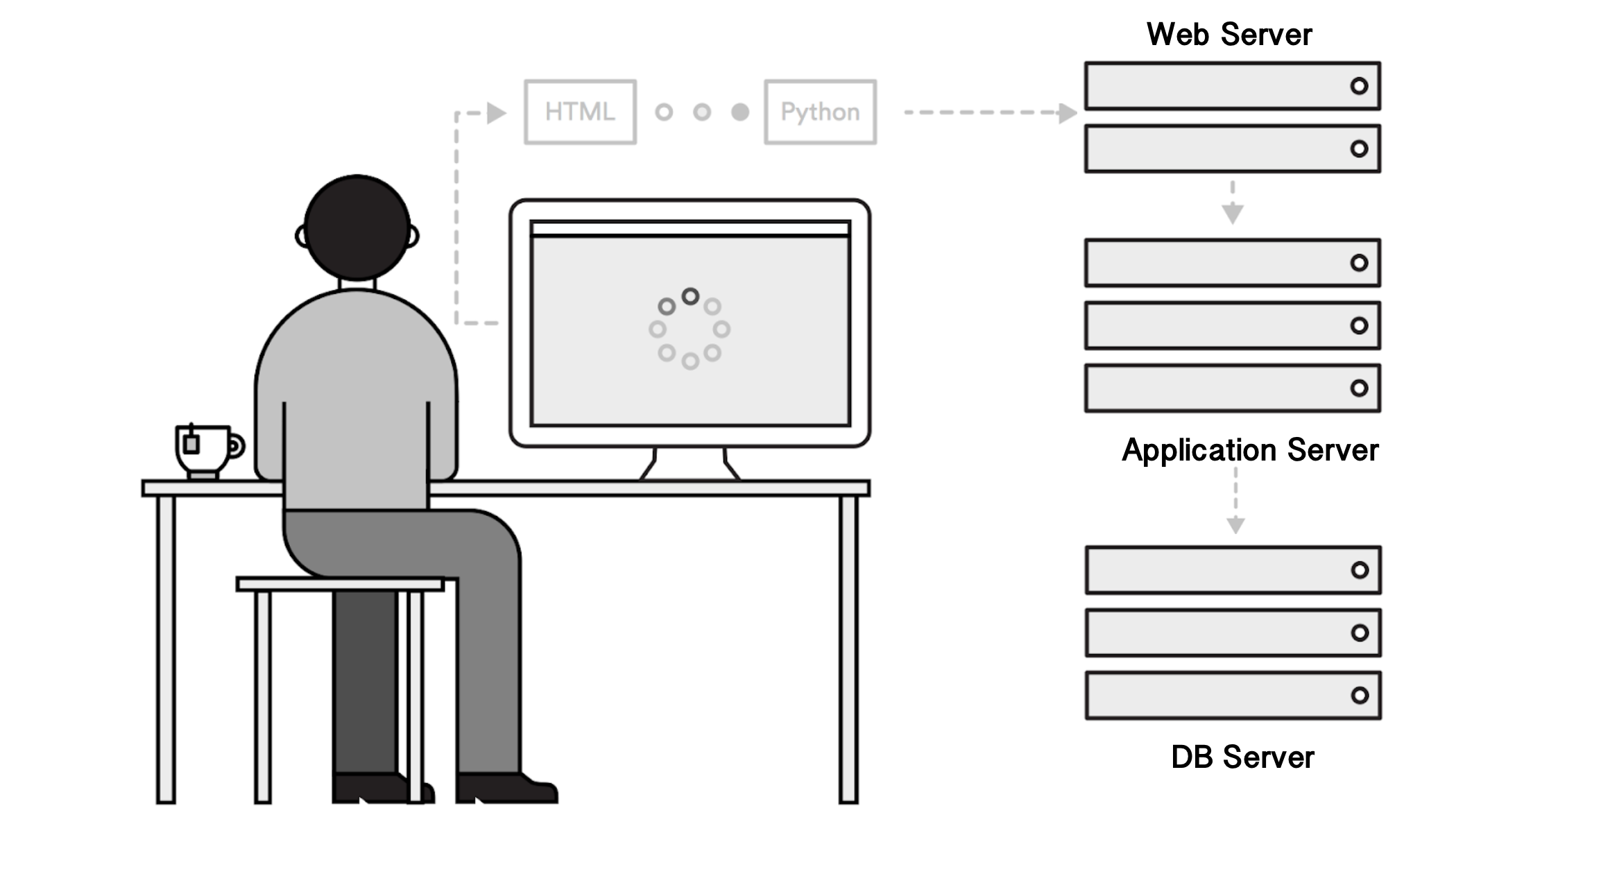

Slide 26
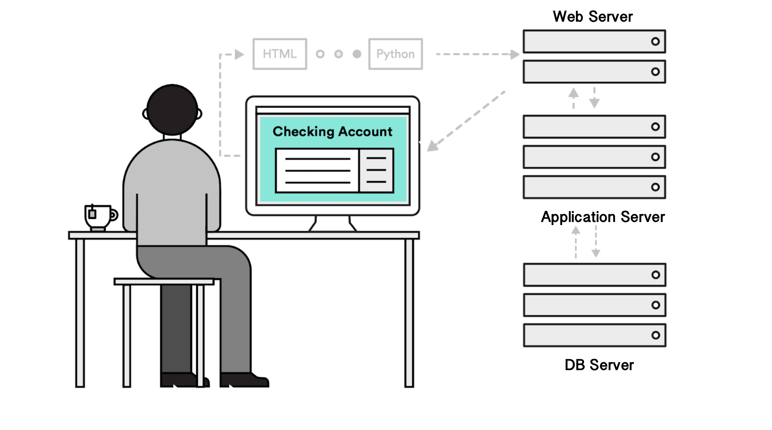
Notes:
My experience working for Macquarie Bank Market Risk
Redeveloped Market Risk systems over 6 years Front & Back end

Slide 27
FRONT END LANGUAGES

Slide 28

FRONT END IS MADE UP OF…
...AND IS KIND OF LIKE...
Javascript
CSS
HTML
Notes:
Can anyone describe how HTML/CSS & Javascript is like a Smart Home ?
HTML = structure/content
CSS = style
Javascript = automation

Slide 29
THE LANGUAGES
FRONT END
HTML | Defines the Content | “The Structure/Content”
CSS | Assigns the style | “The Look”
JAVASCRIPT | Adds the functionality | “The Brain”
Notes:
The three main languages of Front-End Web Development are HTML, CSS and Javascript.

Slide 30
FRONT END
DEEP DIVE INTO HTML + CSS

Slide 31

ACTIVITY: DISTINGUISH BETWEEN HTML, CSS, AND JS
DIRECTIONS
Let’s visit lyft.com together
The words “A Ride in Minutes” appears due to ______?
The reason for which “A Ride in Minutes” is centered and white is due to _______?
Hover over the word “Explore” in the navigation menu. That animation is most likely due to _______?
EXERCISE
Notes:
Continue to think about the different roles the three languages we discussed are playing as you visit more websites.

Slide 32
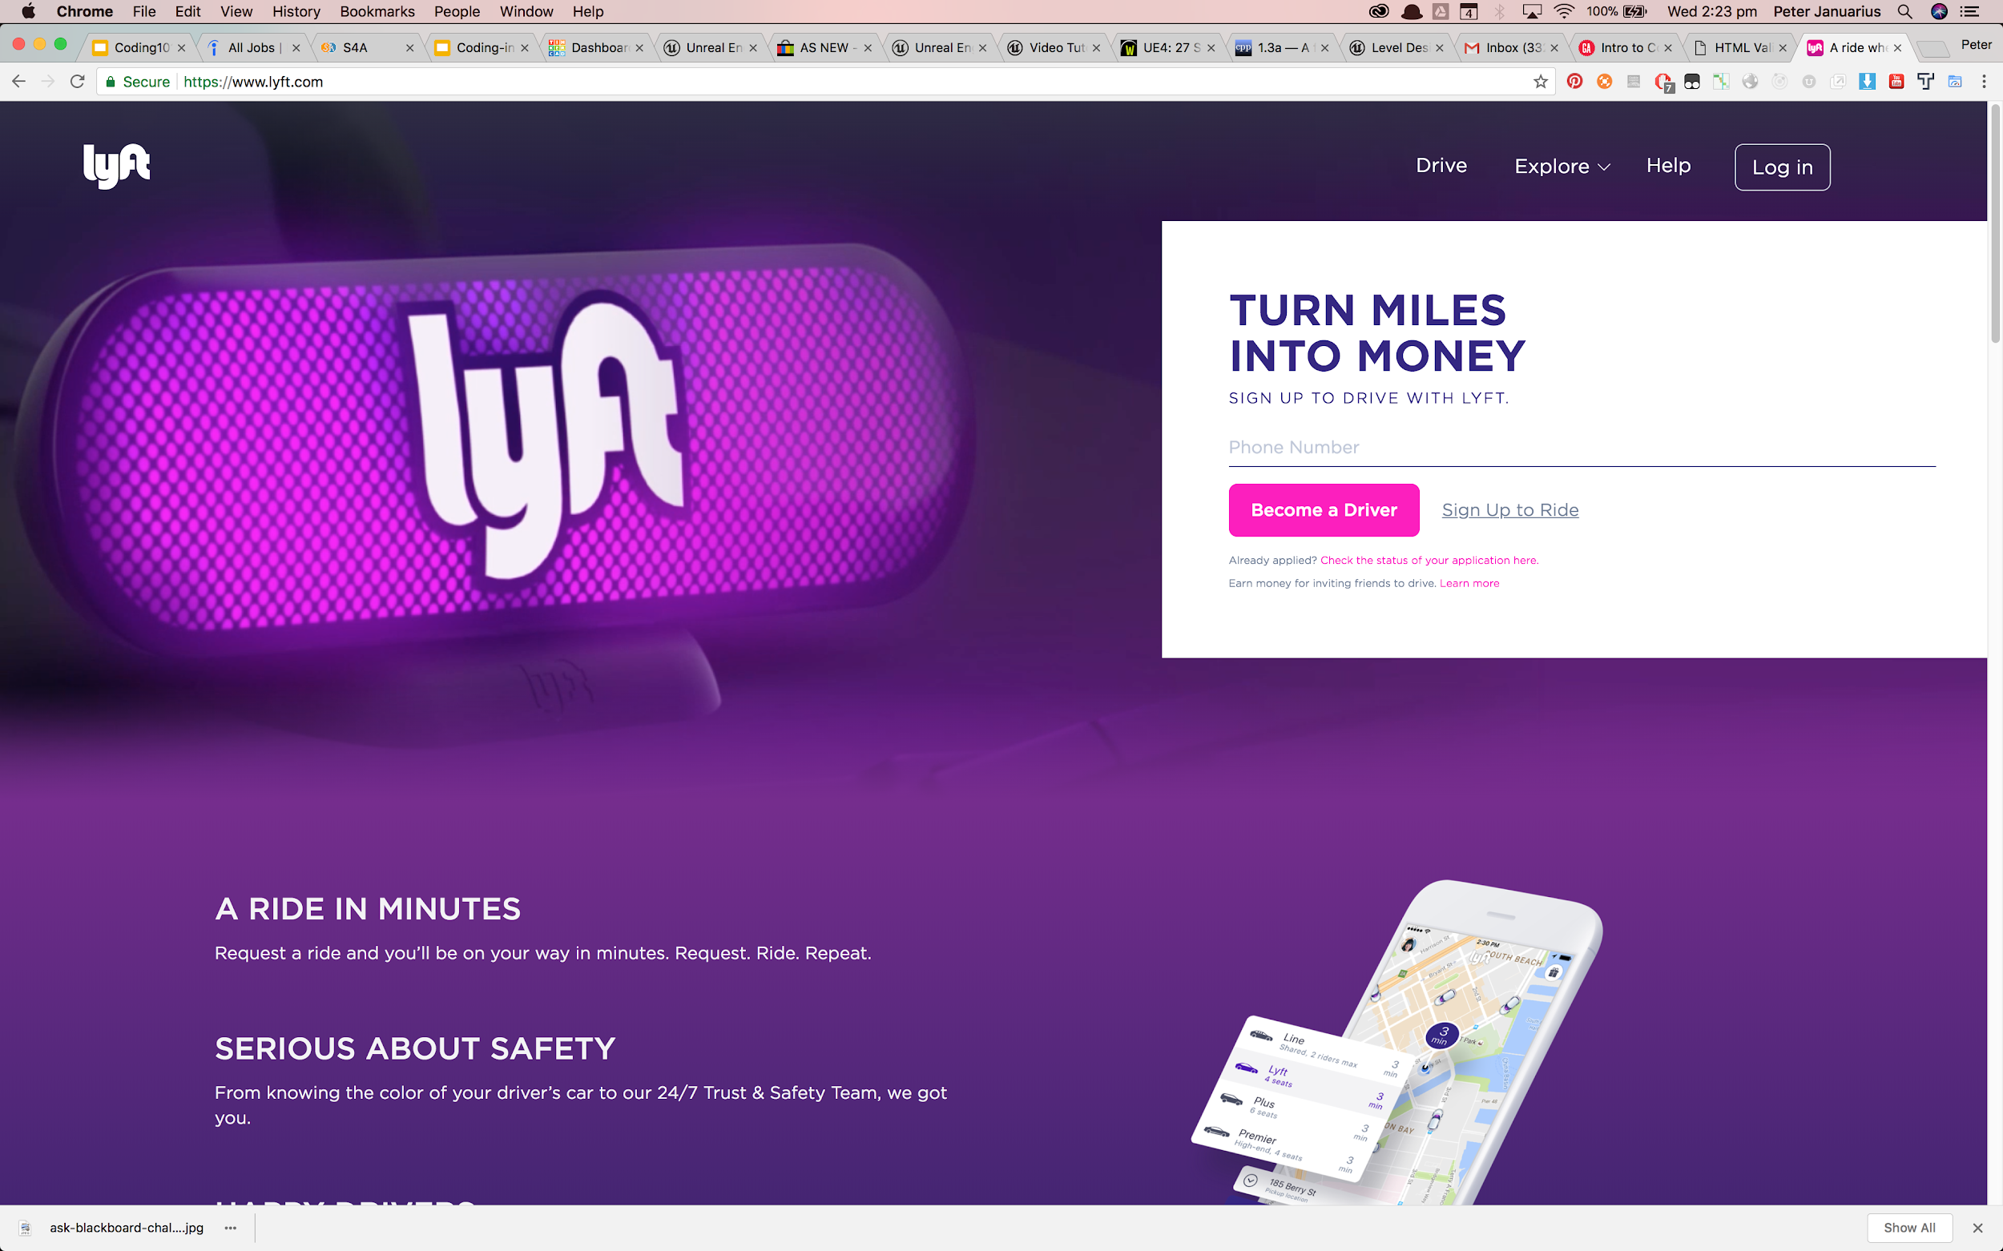
Notes:
Continue to think about the different roles the three languages we discussed are playing as you visit more websites.

Slide 33


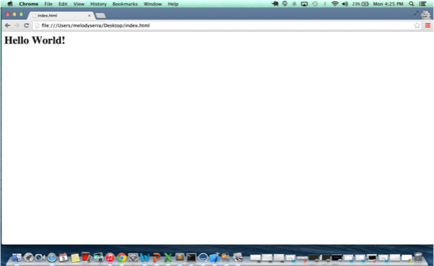
HTML : HYPER TEXT MARKUP LANGUAGE
HTML is made up of tags
Tags = < >
Tags tell the browser how to render (display) content
e.g Will the content be rendered as text, image or link?
<h1>
</h1>
Notes:
Content can be various items, text, images, sound, video, files, links, headings, sections

Slide 34
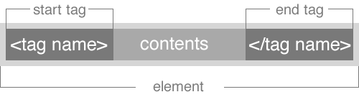
HTML SYNTAX
FRONT END: HTML
Notes:
Not all tags have end tags. It is usually determined by the type of content and whether they have a logical start/end

Slide 35
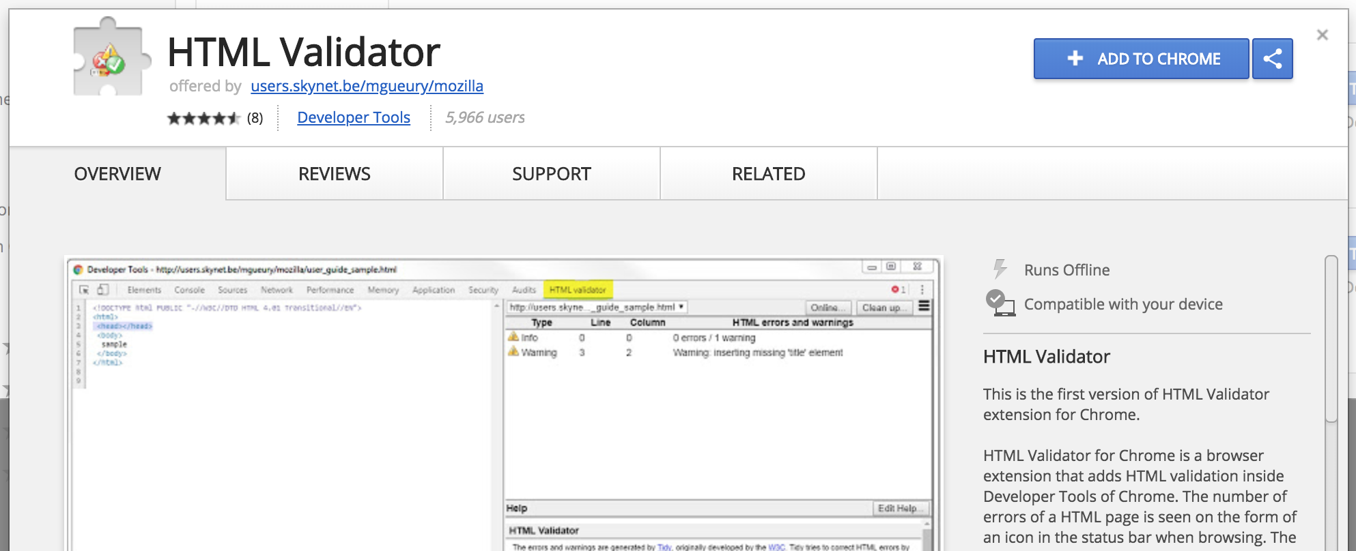
HTML Helpers - 1
FRONT END: HTML
HTML Validators
Notes:
You don’t need to scrutinize your HTML - there are tools that will do it for you!
It will rule out errors potentially caused by invalid HTML

Slide 36
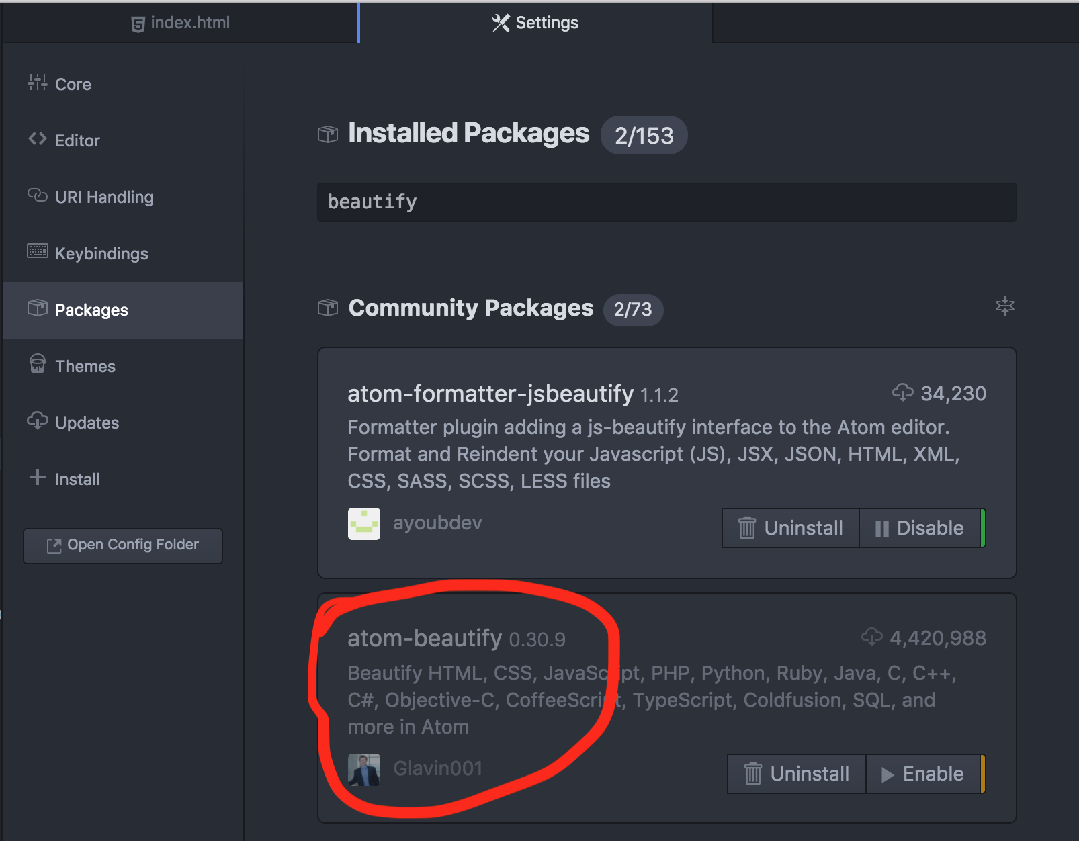
HTML Helpers - 2
FRONT END: HTML
HTML Beautifier

Slide 37
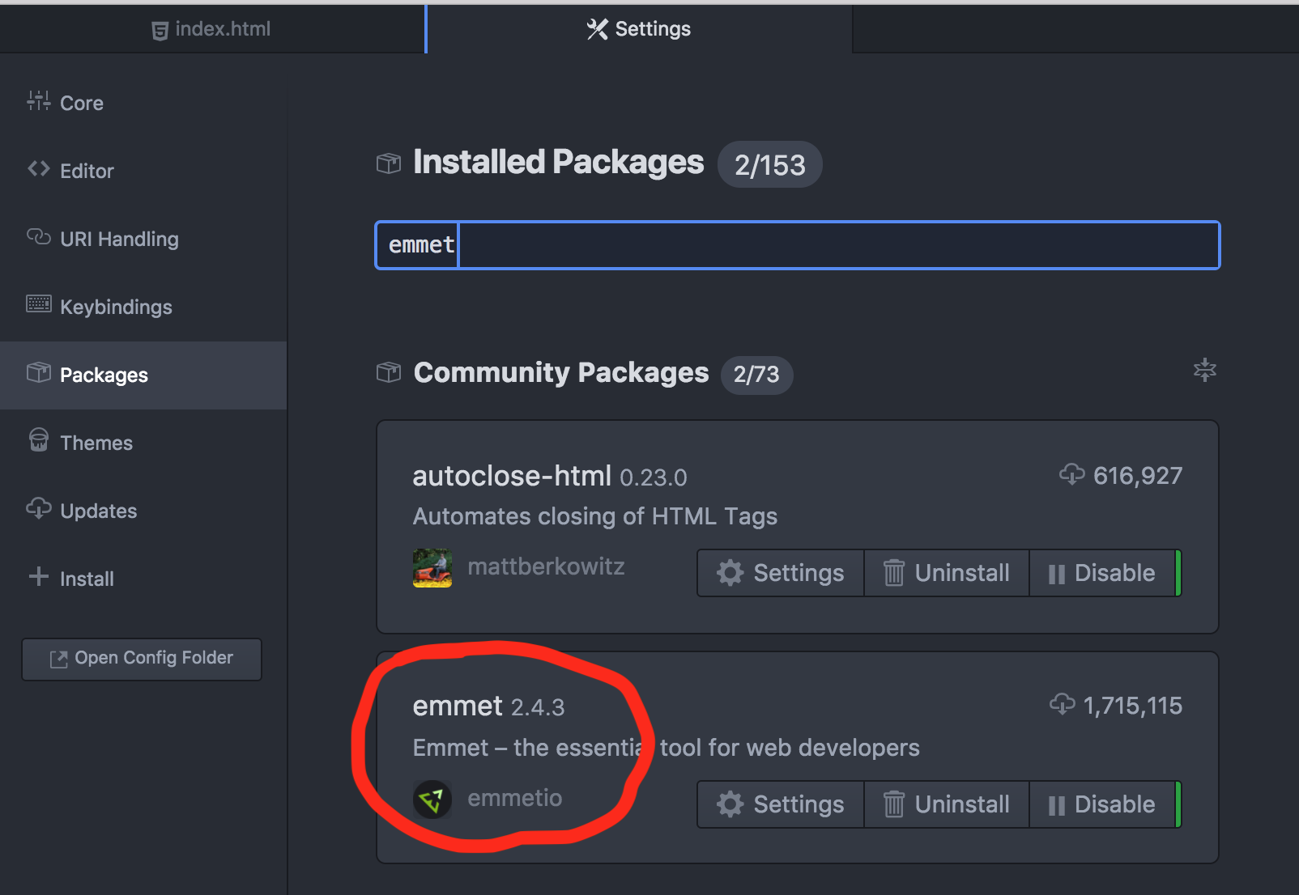
HTML Helpers - 3
FRONT END: HTML
HTML Completion

Slide 38
FRONT END
GUIDED PRACTICE

Slide 39
1. OPEN YOUR BROWSER AND NAVIGATE TO:
https://codepen.io
2. SELECT “Create >New Pen” ON THE TOP RIGHT OF THE PAGE
HTML CODE-ALONG
Notes:
Students should be able to create a New Pen without signing up for Code-pen or having a Login.
As an instructor, you can use the pre-populated code at http://codepen.io/anon/pen/yvDAo to show students HTML structure, or start from scratch. Demonstrate the following:
heading tags
paragraph tags
list tags and ordered, unordered list items
image tags
Use this time mostly to show an example of what you can do with HTML rather than explaining the intricacies of each of the tags/attributes, etc.
Students can, but don’t necessarily need to, type this on their screens. They can just watch for now.

Slide 40
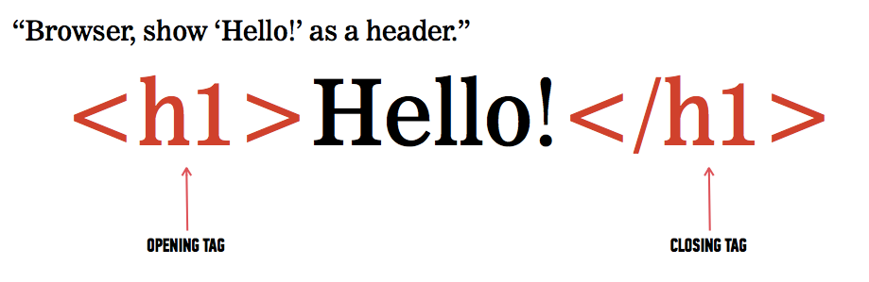
HTML CODE-ALONG

Slide 41
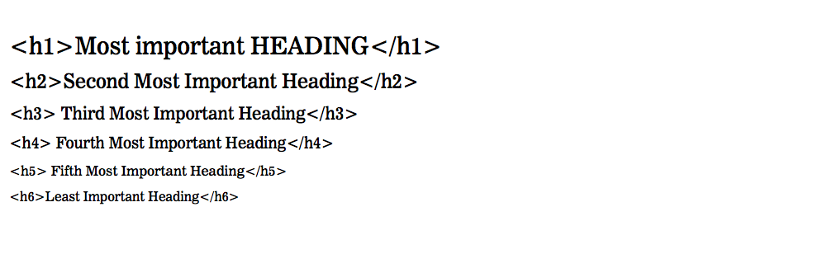
HTML CODE-ALONG

Slide 42
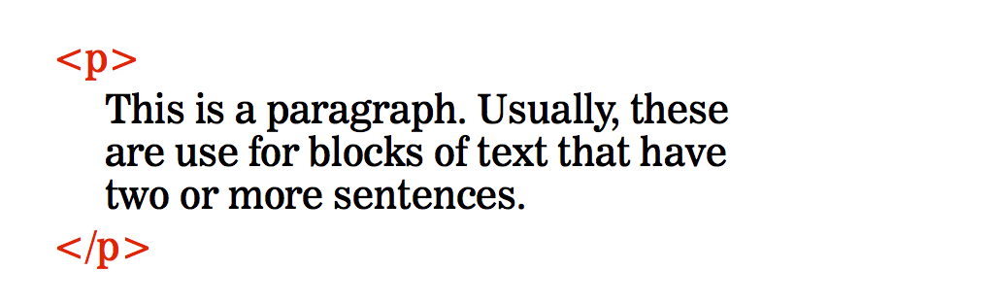
HTML CODE-ALONG

Slide 43
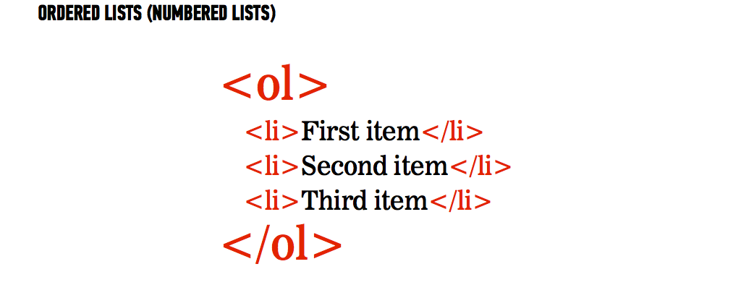
HTML CODE-ALONG

Slide 44
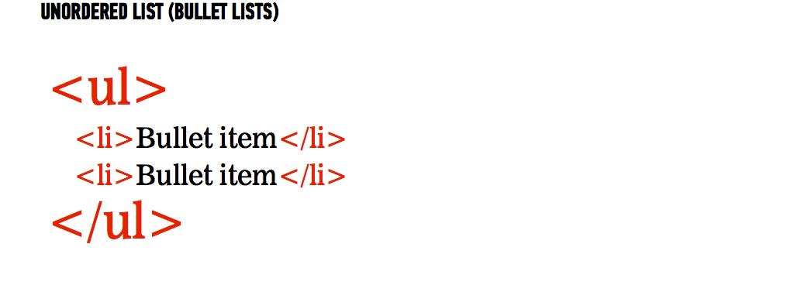
HTML CODE-ALONG

Slide 45

PLACE KITTEN
THE IMAGE TAG
<img src=“https://placekitten.com/g/500/600”/>
<img src=“”/>

Slide 46
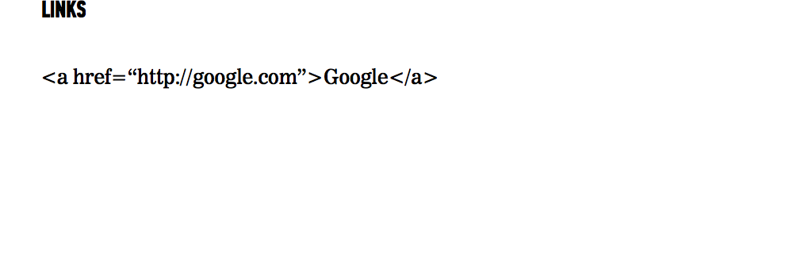
HTML CODE-ALONG
<a href=“”/>Label</a>

Slide 47
HTML
BASIC LAYOUT OF AN HTML DOCUMENT

Slide 48
HTML
<!DOCTYPE html>
<html>
<head> sets off title and info that won’t be displayed
<title>My first webpage</title>
<meta charset="UTF-8"> sets character encoding
</head>
<body> visible portion
<h1>Hello World!</h1>
</body>
</html> ends the HTML document

Slide 49
ACTIVITY: CREATING YOUR FIRST HTML FILE
DIRECTIONS
Create a folder on your desktop and title it “Coding 101”
Open up the folder you just made in your text editor
Save your file as “index.html”
Type out the HTML basic layout
Open up the HTML file in Google Chrome
Add more content tags: h1-h6, p, ul/li, button, a, img to create an “About Me” webpage
Keep your editor open
EXERCISE

Slide 50
CSS : CASCADING STYLE SHEETS
BASIC LAYOUT OF AN EXTERNAL CSS FILE

Slide 51

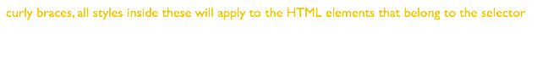
CSS : CASCADING STYLE SHEETS
CSS tells the browser how to style content
e.g Will the paragraph content be pink or purple?
h1 {
color: #FF9966;
text-align: center;
}
property
Notes:
Talk about each part of the CSS rule
The selector
The braces
The style rules

Slide 52
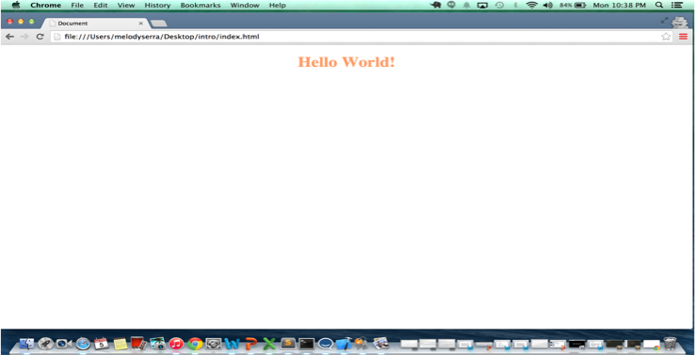
HOW DO YOU CONNECT CSS FILES TO HTML FILES?
<link rel=“stylesheet” href=“style.css”>

Slide 53
ACTIVITY: CREATING YOUR FIRST CSS FILE
DIRECTIONS
You should still have the “Coding 101” folder open in your editor
Create a new file from the editor, save the file as “style.css”
Add a few CSS properties(color, background-color, font-family, text-align) to the content created in the last activity
Connect your external CSS file to your HTML file
Open up the HTML file in Google Chrome
EXERCISE

